Slide 1
NACP Pilot: Advancing Liver Cancer Prevention for
Arizona American Indian Communities
University of Arizona Northern Arizona University
David O. Garcia, Ph.D. Priscilla R. Sanderson, Ph.D.
Edgar Villavicencio, MPH Morgan Vigil-Hayes, Ph.D.
Timian Godfrey, DNP Melissa Howard
Kimberly Shea, Ph.D.
Xiaoxiao Sun, Ph.D.
Krystelle Boyd IRB Approval: University of Arizona
Resolution Approval: Western Agency Council

Slide 2
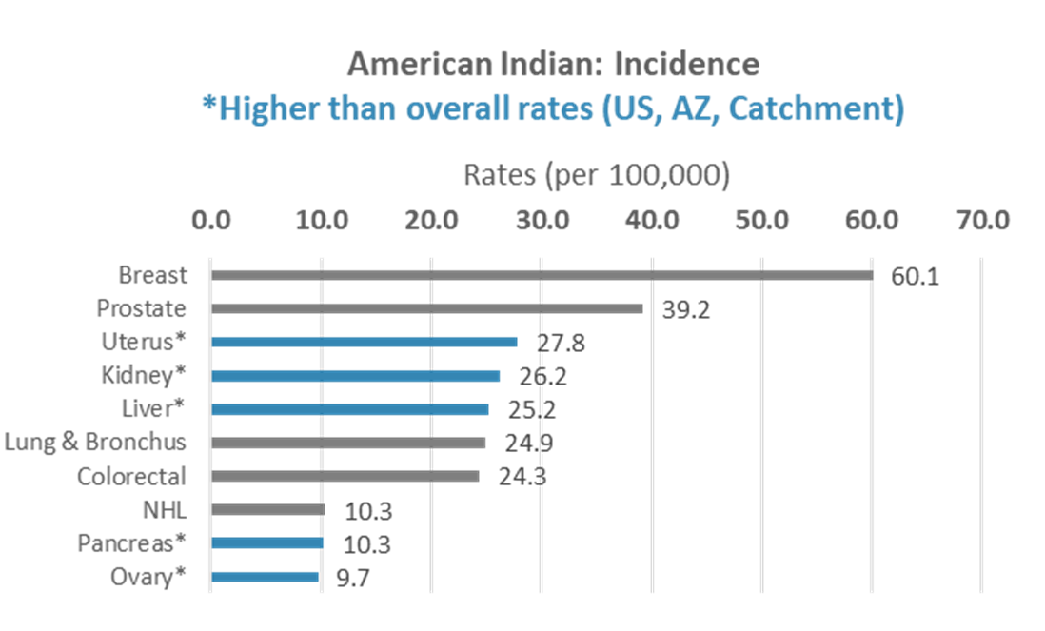
Cancer Incidence
Significant cancer disparities for Indigenous People include:
Uterus
Kidney
Liver
Pancreas
Ovary

Slide 3
Cancer Mortality
Non-alcoholic fatty liver disease (NAFLD) is a risk factor for liver cancer
Risk factors for NAFLD include:
Central obesity
Type 2 diabetes mellitus
High cholesterol
Metabolic syndrome
High blood pressure

Slide 4
What is NAFLD?
Non-alcoholic fatty liver (NAFL)
> 5% liver fat without any evidence of liver cell injury or inflammation
Non-alcoholic steatohepatitis (NASH)
> 5% liver fat with evidence of liver cell injury and inflammation
Saab et al., 2016

Slide 5
Treatment for NAFLD
Currently no FDA-approved pharmacological treatments exist – lifestyle modification (diet, physical activity) is the recommended therapy for NAFLD
Saab et al., 2016

Slide 6
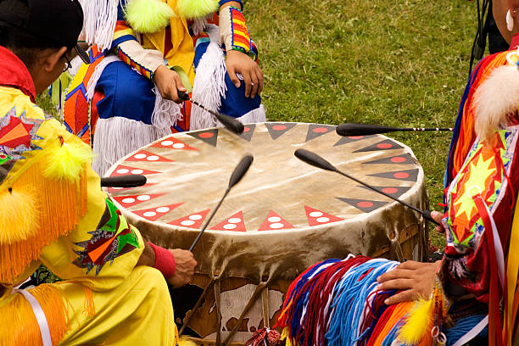
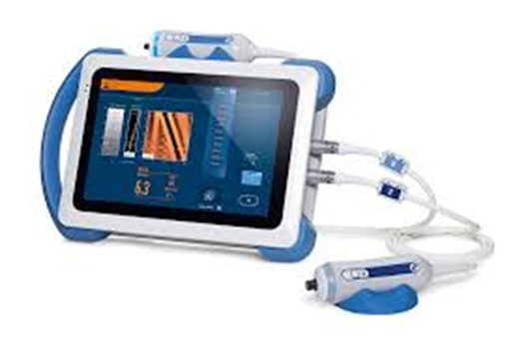
Specific Aims
Specific Aim 1: Explore attitudes and beliefs of liver cancer health risk held by community members of Navajo Nation (n=20) and Tohono O’odham Nation (n=20).
Specific Aim 2: Characterize and determine risk factors for liver cancer in a community-based sample of 200 adults in Navajo Nation (n=100) and Tohono O’odham Nation (n=100).
Specific Aim 3: Evaluate the feasibility and acceptability of a culturally and clinically relevant telehealth assessment for liver and other cancer-related risk factors.
Notes:
Specific Aim 1) To explore attitudes and beliefs of liver cancer health risk (e.g., lifestyle, biological, environmental) held by community members of Navajo Nation and Tohono O’odham Nation.
We will identify the knowledge base of liver cancer health risk in adult community members from Navajo (n=20) and Tohono O’odham Nation (n=20). We also will examine strategies for communicating liver cancer health risk and participants’ preferences regarding telehealth risk assessment strategies including health care access, current use of technology, and barriers to health care access due to the COVID-19 pandemic.
Specific Aim 2) To characterize and determine risk factors (e.g., lifestyle, biological, environmental) for liver cancer in a community-based sample of 200 adults in Navajo Nation and Tohono O’odham Nation.
We will recruit and screen 100 participants with a sex breakdown of Navajo women (n=50) and men (n=50) who are at high risk for liver disease with the use of transient elastography (FibroScan®). In addition, we will investigate non-modifiable and modifiable risk factors (demographic characteristics, lifestyle behaviors, and psychosocial risk factors) by having participants complete a set of questionnaires. Specifically, questionnaires will be provided in the participants' language of preference (we will work collaboratively with interpreters; NAU team has a Project Coordinator who will interpret Navajo language) and will include demographic, medical history, diet, and a physical assessment.
Specific Aim 3) To evaluate the feasibility and acceptability of a culturally and clinically relevant telehealth assessment for liver and other cancer-related risk factors.

Slide 7
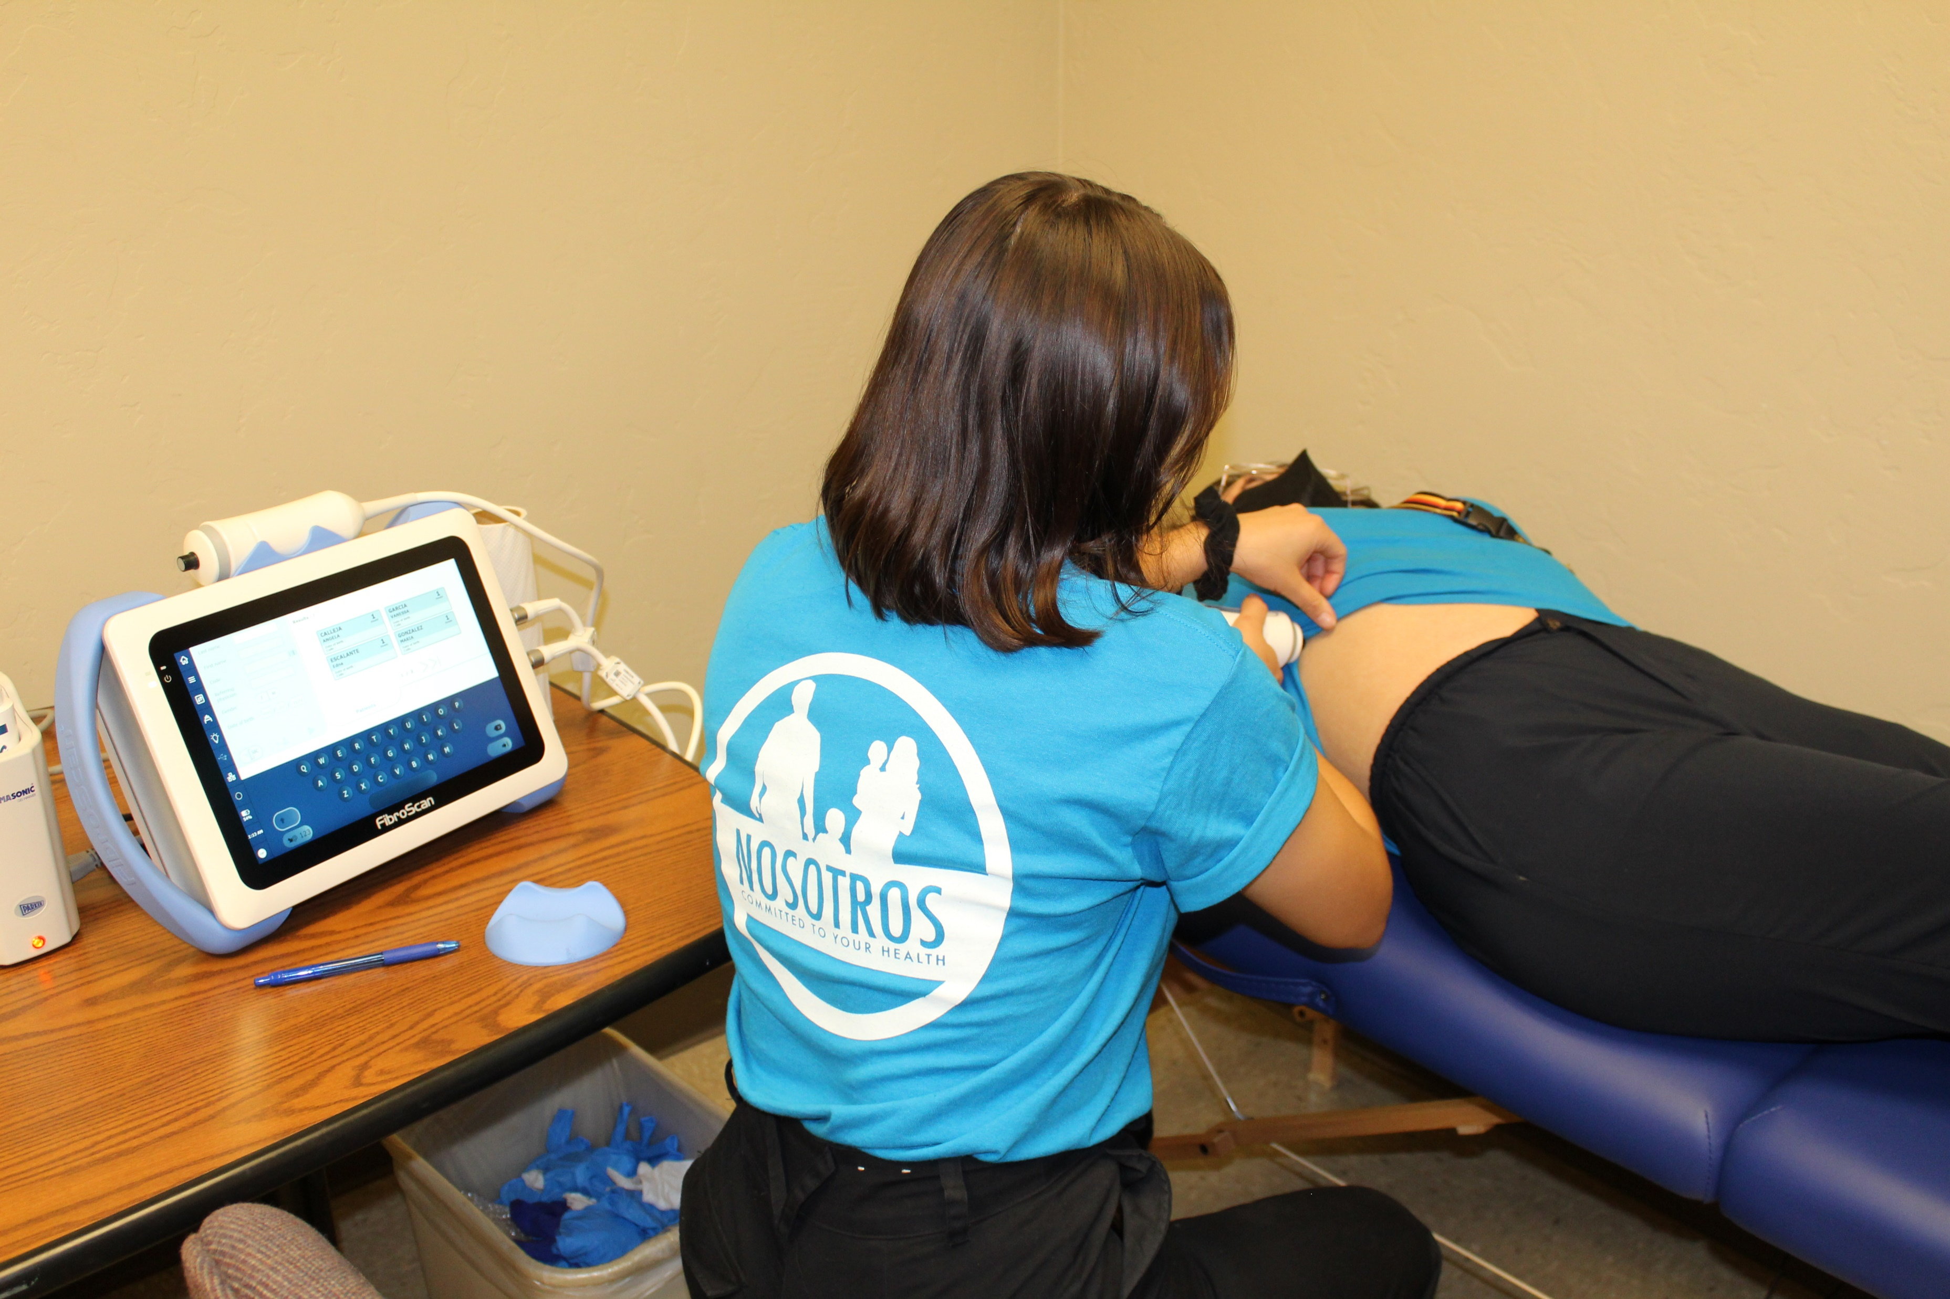
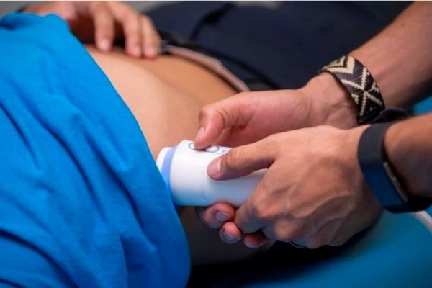
FibroScan®
NAFLD status identified via Fibroscan®
10-15 min non-invasive procedure (FDA approved) that assess for:
Continuous Attenuation Parameter (CAP) value ranging from 100 - 400 dB/m
238 to 259 dB/m – Steatosis grade 1, mild
260 to 290 dB/m – Steatosis grade 2, moderate
290 dB/m and higher – Steatosis grade 3, severe
Liver Stiffness Measurement (LMS) value ranging from 1.5 - 75 kPa
2-7 kPa for mild liver scarring
7-10 kPa for moderate liver scarring
10-14 kPa for severe liver scarring
14 kPa and higher for advance liver scarring (cirrhosis)

Slide 8
Study Workflow

Slide 9
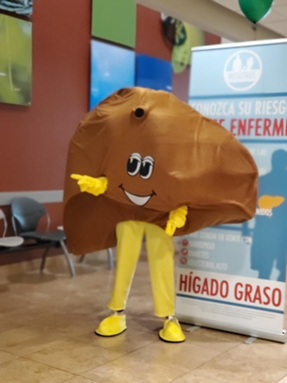
Community Involvement
Goal: Develop two community advisory committees (CACs) of liver cancer survivors, caregivers, and those directly affected by liver disease prior to starting research related activities for each tribe.
Recruit 6 CAC members for Navajo and TO communities with the goal to complete recruitment by April 2023
CAC Members: Refine our research approaches and collaborate with CAC members on research capacity building process for Navajo and TO communities.
Upon receiving IRB approval: Begin outreach activities, education/information workshops in community settings, and assessments of cultural knowledge and awareness of liver disease and liver cancer
Begin data collection for research related activities

Slide 10
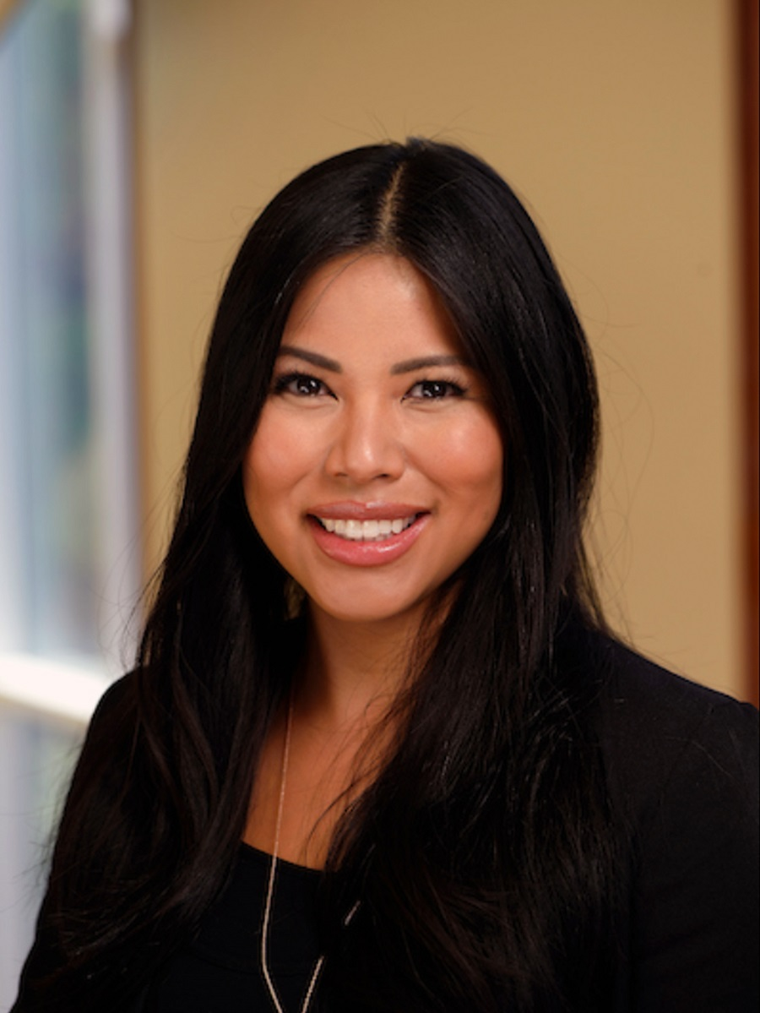
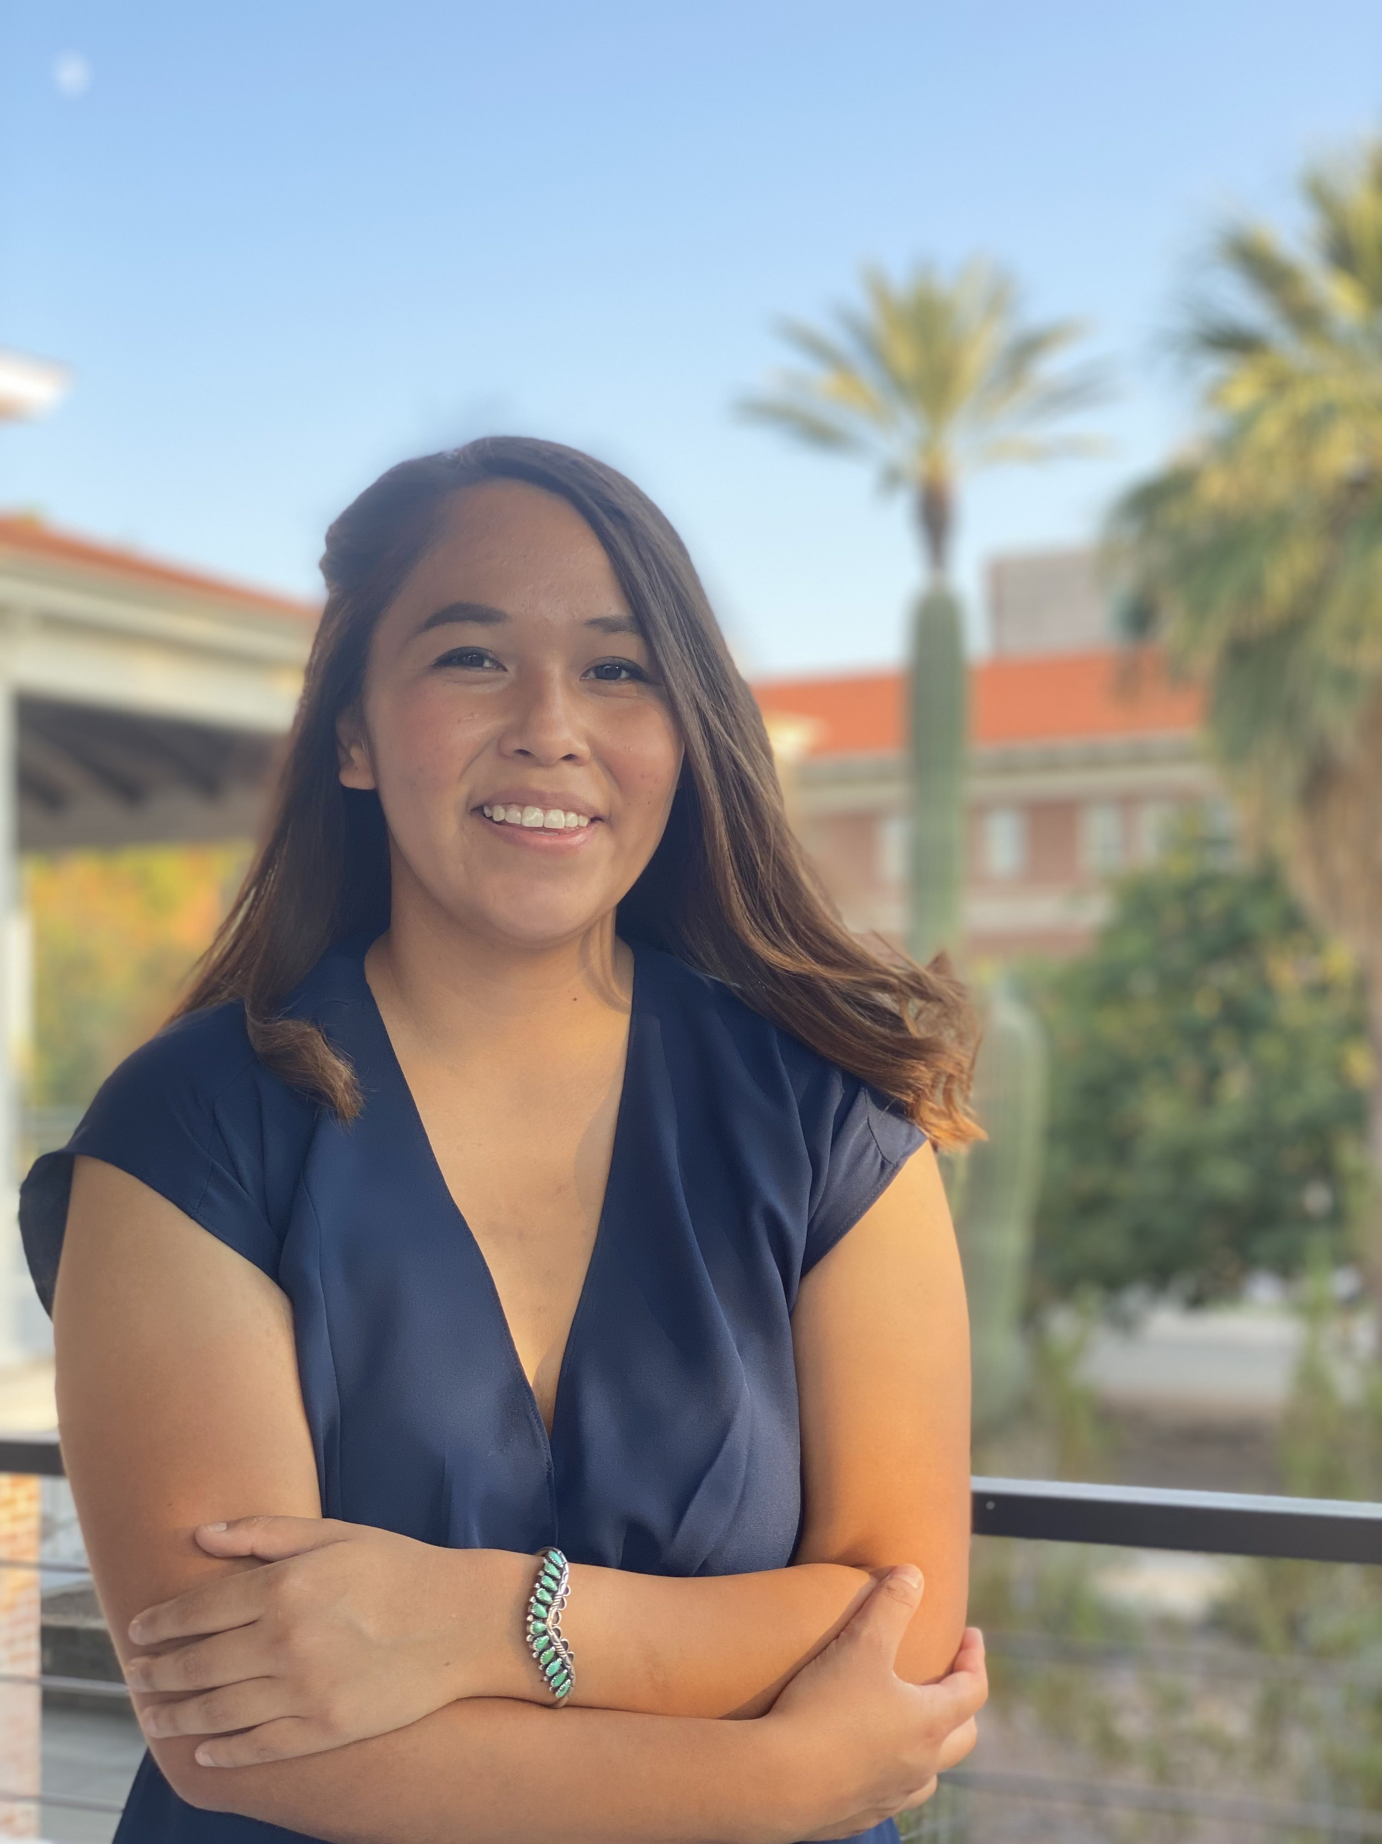
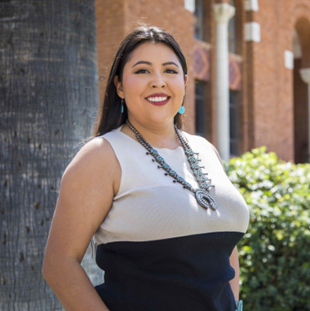
Professional Education and Development
Goal: Engage American Indian students from community colleges and who have not had training or experience in lifestyle and health outcomes research and community engagement firsthand
Dr. Timian Godfrey, Diné
Co-Investigator
PhD Student ASU
Carol Seanez, Diné
UA MPH Epidemiology
Incoming PhD Student UA
Melissa Howard, Diné
NAU Undergraduate
Krystelle Boyd, Diné
UA MPH Epidemiology

Slide 11
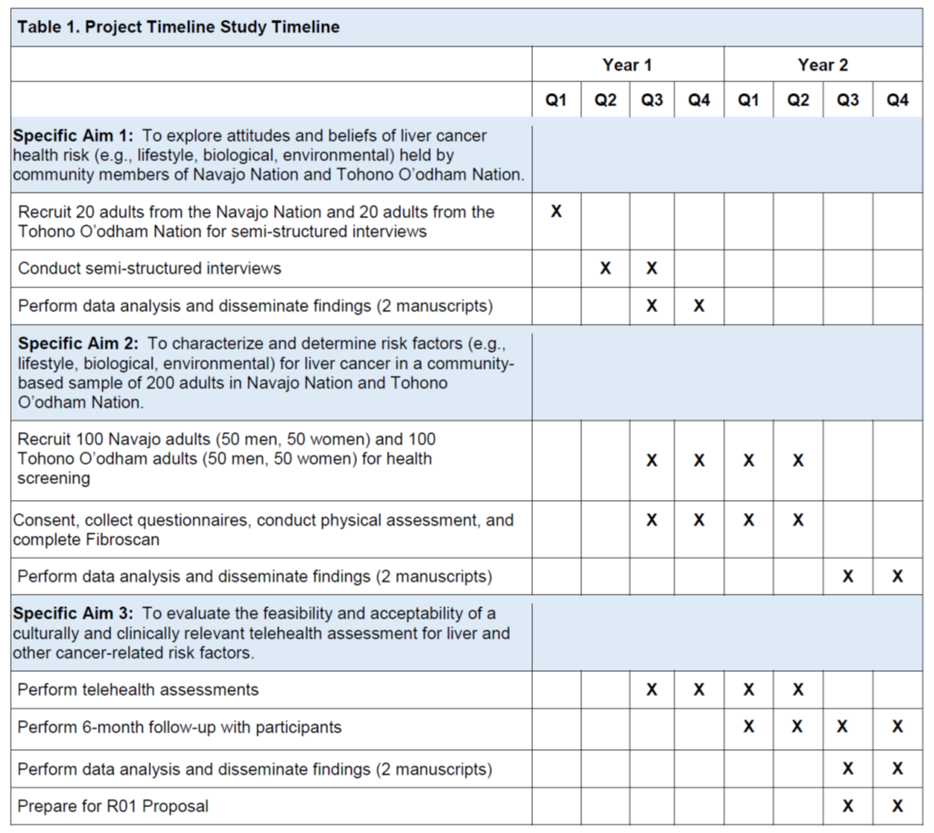
Study Timeline

Slide 12
Thank you! Questions?

